Slide 1





Overview
G443
SERAN
A Security-Enhanced Radio Access Network
SERAN helps 5G Network Operators,
who need Secure and Resilient Operations,
by augmenting the industry-led SD-RAN,
with state-of-the-art Security Services
SRI International
Ohio State University
AccuKnox, Inc.
NSF’s Convergence Accelerator Curriculum
Phase 1

Slide 2
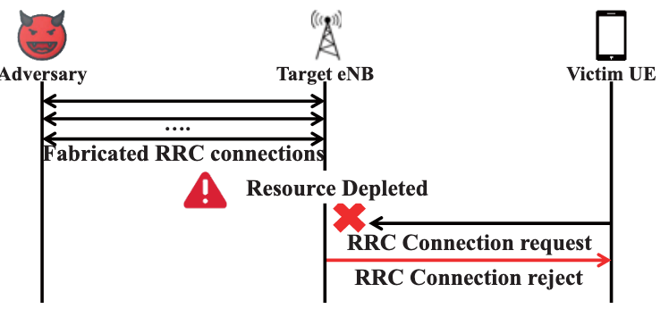
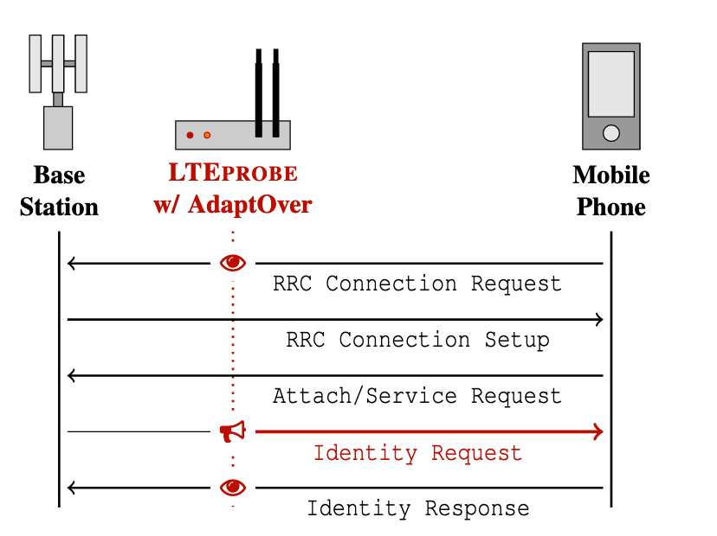
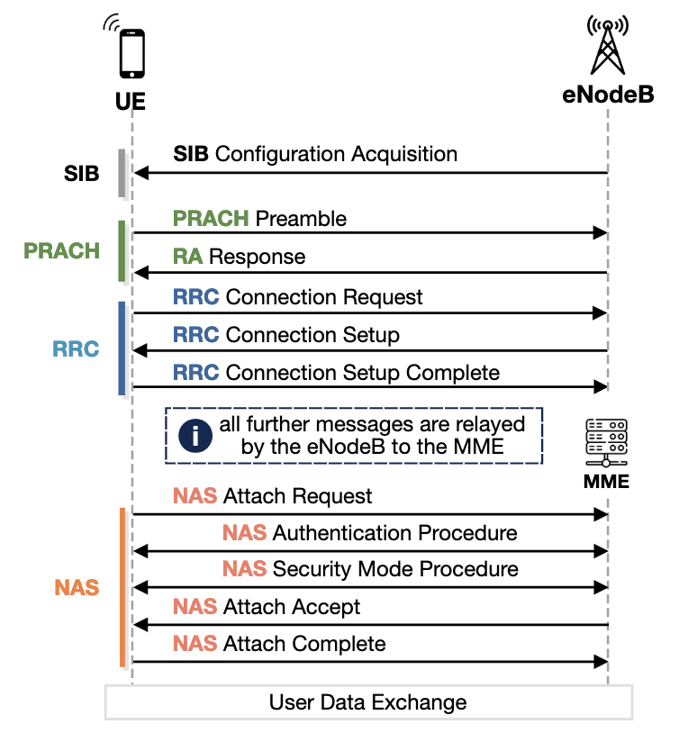

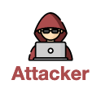

Why
Recent Published Attacks
The Challenge The Opportunity
2019-2022
Evil SDR
5G+ Attacks | Vector | Source | Victim | Class / Method
BTS Resource Depletion | RRC | UE | gNB | DoS/ Resource Exhaustion
DoS w/ rrc_conn_req | RRC | UE | UE | DoS/Spoof
DoS w/ rrc_reestablish | RRC | UE | UE | DoS/Spoof
DoS w/ rrc_resume_req | RRC | UE | UE | DoS/Spoof
Uplink DoS (bad MAC) | RRC | SDR | UE | Confidentiality / Sig Inject
Uplink DoS (bad IMSI) | RRC | SDR | UE | Confidentiality / Sig Inject
Upplink IMSI Extractor | RRC | SDR | UE | Confidentiality / Sig Inject
Downlink IMSI Extractor | RRC | SDR | UE | Confidentiality / Sig Inject
Variant Downlink IMSI Extr | RRC | SDR | UE | Confidentiality / Sig Inject
Variant Downlink TMSI Extr. | RRC | SDR | UE | Confidentiality / Sig Inject
Null Cipher / Null Integrity | RRC | SDR | UE | Privacy / Sig Injection
Signal Injects
UE/gNB DoS
Spoofing, Privacy
Geo-Tracking
gNB
Attacks
RU
DU
CU
gNB
SIB
Config Acquisition
RIC
xApps
PRACH
Preamble
Response
Connect Request
Control Layer
RRC
Connect Setup
Setup Connect
Kubernetes
Attacks
Downlink Dos nas_attack_reject | NAS | SDR | UE | DoS/Spoof
Downlink Dos nas_service reject | NAS | SDR | UE | DoS/Spoof
Remote deregistration | NAS | UE | UE | Privacy / Replay
Authe Sync Failure | NAS | UE | UE | Privacy / Spoofing
Attach Request
NAS
Auth Procedure
Auth Security Mode
Attach Accept
Attach Complete
NSF’s Convergence Accelerator Curriculum
Phase 1
DATA
SMS
IP / VoIP

Slide 3
Why
Recent Published Attacks
The Challenge The Opportunity
2019-2022
Evil SDR
5G+ Attacks | Vector | Source | Victim | Class / Method
BTS Resource Depletion | RRC | UE | gNB | DoS/ Resource Exhaustion
DoS w/ rrc_conn_req | RRC | UE | UE | DoS/Spoof
DoS w/ rrc_reestablish | RRC | UE | UE | DoS/Spoof
DoS w/ rrc_resume_req | RRC | UE | UE | DoS/Spoof
Uplink DoS (bad MAC) | RRC | SDR | UE | Confidentiality / Sig Inject
Uplink DoS (bad IMSI) | RRC | SDR | UE | Confidentiality / Sig Inject
Upplink IMSI Extractor | RRC | SDR | UE | Confidentiality / Sig Inject
Downlink IMSI Extractor | RRC | SDR | UE | Confidentiality / Sig Inject
Variant Downlink IMSI Extr | RRC | SDR | UE | Confidentiality / Sig Inject
Variant Downlink TMSI Extr. | RRC | SDR | UE | Confidentiality / Sig Inject
Null Cipher / Null Integrity | RRC | SDR | UE | Privacy / Sig Injection
Signal Injects
UE/gNB DoS
Spoofing, Privacy
Geo-Tracking
gNB
Attacks
RU
DU
CU
Existing infrastructures cannot see
these attacks… let alone stop them
gNB
SIB
Config Acquisition
RIC
xApps
PRACH
Preamble
Response
Connect Request
Control Layer
RRC
Connect Setup
Setup Connect
Kubernetes
Attacks
Downlink Dos nas_attack_reject | NAS | SDR | UE | DoS/Spoof
Downlink Dos nas_service reject | NAS | SDR | UE | DoS/Spoof
Remote deregistration | NAS | UE | UE | Privacy / Replay
Authe Sync Failure | NAS | UE | UE | Privacy / Spoofing
Attach Request
NAS
Auth Procedure
Auth Security Mode
Attach Accept
Attach Complete
NSF’s Convergence Accelerator Curriculum
Phase 1
DATA
SMS
IP / VoIP

Slide 4

Why
The Opportunity The Challenge
Thesis: SD-RAN-based 5G+ infrastructures are
extensible to security
The industry-led redesign of 5G infrastructures using a software-defined abstraction offers
1. Modular extensibility and open APIs
2. Disaggregation between data and control planes
A Global
Control
Plane
Data
Plane
NSF’s Convergence Accelerator Curriculum
Phase 1

Slide 5
Why
The Opportunity The Challenge
Thesis: SD-RAN-based 5G+ infrastructures are
extensible to security
The industry-led redesign of 5G infrastructures using a software-defined abstraction offers
1. Modular extensibility and open APIs
2. Disaggregation between data and control planes
A Global
Control
Plane
Prior mobile architectures were
monolithic and closed systems
Data
Plane
NSF’s Convergence Accelerator Curriculum
Phase 1

Slide 6

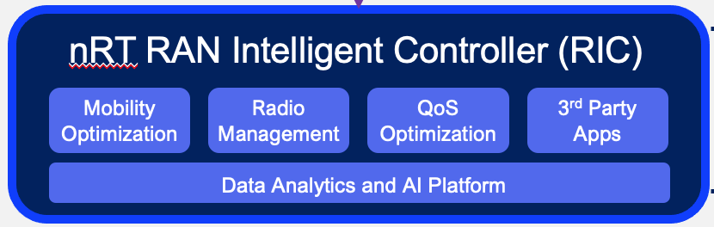
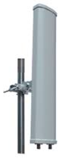
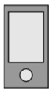

How
SERAN
Control Plane
Value Proposition
With MINIMAL cost to you, we can modularly insert some very critical security services
Open
APIs
Data Plane
Control
Unit
Data
Unit
Radio
Unit
Phone
NSF’s Convergence Accelerator Curriculum
Phase 1

Slide 7

How
SERAN
Control Plane
Value Proposition
With MINIMAL cost to you, we can modularly insert some very critical security services
5G-IDS
AI-Sec
5G-Aware Runtime Policy
Enforcement
Deliverables
Data Plane
SecSM :: Security Service Module
MobiFlow :: The first RRC/NAS security audit trail
SecSM
Open
APIs
MobiFlow
Control Plane
5G-IDS :: The first Runtime gNB detection and
countermeasure engine
AI-SEC :: An RRC/NAS (UE-to-gNB) anomaly
threat classification system
E2T
Data Plane
SecSM
Control
Unit
Data
Unit
5G-KubeArmor :: 5G-aware runtime policy enforcement
for the SD-RAN control layer
Radio
Unit
Phone
NSF’s Convergence Accelerator Curriculum
Phase 1

Slide 8

G443
Communications & Pitching
SERAN
Security-Enhanced Radio Access Networks
5 G S E C . C O M

