Slide 1
RILDefender
A Radio Interface Layer (RIL) Privacy Mediation Service for Android Smartphones
The Ohio State
University
SRI International

Slide 2
SMS Attacks
Our definition: an SMS engagement that occurs without the UE owner’s knowledge or consent, violating the owner’s privacy, security, or UE availability
Silent SMS
Type-0 SMS are typically associated with covert triangulation of UEs by law enforcement, nation states, and adversaries who submit Silent SMS for flooding attacks or geo-tracking.
Flash SMS
Class 0 SMS can be sent by authorities and malicious attackers to produce pop-up windows on the UE. Malicious flash SMS DoS attacks and fake alerts have been demonstrated.
Binary SMS attacks
SMS messages can contain SIM binary attachments that inject surreptitious code logic in victim devices without the knowledge or consent. Examples include SimJack, WIBAttack, and other Binary SMS-based attacks.

Slide 3
SMS Attacks (continued)
Our definition: an SMS engagement that occurs without the UE owner’s knowledge or consent, violating the owner’s privacy, security, or UE availability
Fake base stations
Hosted on SDRs, an attacker can send fraud and spam SMSs to nearby users. In some geo-regions, malicious FBS SMS are prevalent, significant criminal source of revenue, and facilitate other SMS attack scenarios beyond SMS Phishing.
Proactive SMS
Supply-chain SIM-embedded SMS logic allows SIMS to send SMSs without the user's knowledge or permission. All Mobile operators (MOs) SIMs utilize Proactive SMS logic of some form without the public's knowledge. Unfortunately, proactive SMS logic could be used for intel gathering purposes by MOs that operate in authoritarian locations.
Malware SMS
Malware links often spread over SMS or are hidden in mobile app stores, luring users to install and grant privileges. Remote attacker then uses the malware to initiate calls or send covert SMS - both for C&C and propagation.

Slide 4
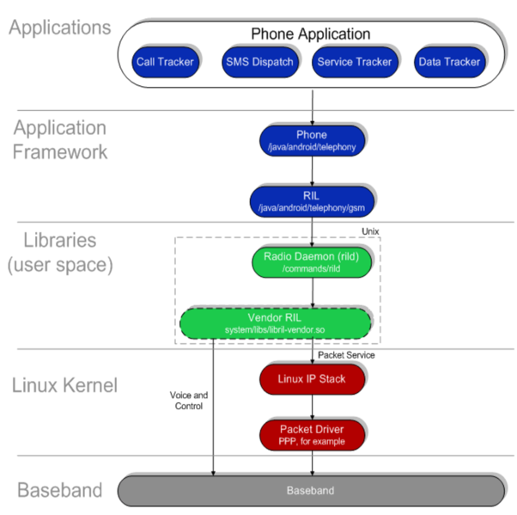
What is the Radio Interface Layer (RIL)?
AP - Application Processor (think Android Space)
CP - Communication Processor (think Baseband Space)
Android's Radio Interface Layer (RIL) provides an abstraction layer between Android telephony services (android.telephony) and radio hardware.
Handle AP-CP communication (IPC)
Packed in the AP, and is modifiable vis OS update
Contain rich cellular functions
Accessing RIL requires root privilege

Slide 5
SMS Processing Logic
SMS processing in RIL code (Samsung Galaxy A51 5G)
CP
AP

Slide 6
RILDefender
RILDefender integrates into the Android Open Source Project (AOSP)
Google Pixel XL and Nexus 6, with the latest possible OS version 10.0.0 and 7.1.1, respectively
RIL and RILDefender run on AP
Application Processor
Config +
Alerts
Cellular Processor
There are 22 other RIL Managers
RILDefnder
UI
Inbound SMS
SMS Manager
Outbound SMS
Inbound SMS
SMS.app
Baseband
Dailer.app
Cellular Info
Outbound SMS
RIL Cmnds
Android
Detection Logic
Policy
(detect,
block
Radio Interface Layer
RILDefender
BP Log
Analyzer
R2U S2U U2U I2U
RILDefender
Inline
SMS
Analyzer
User
Intent
Detector
RILDefender enables
Baseband Logger
(a functional abstraction)

Slide 7
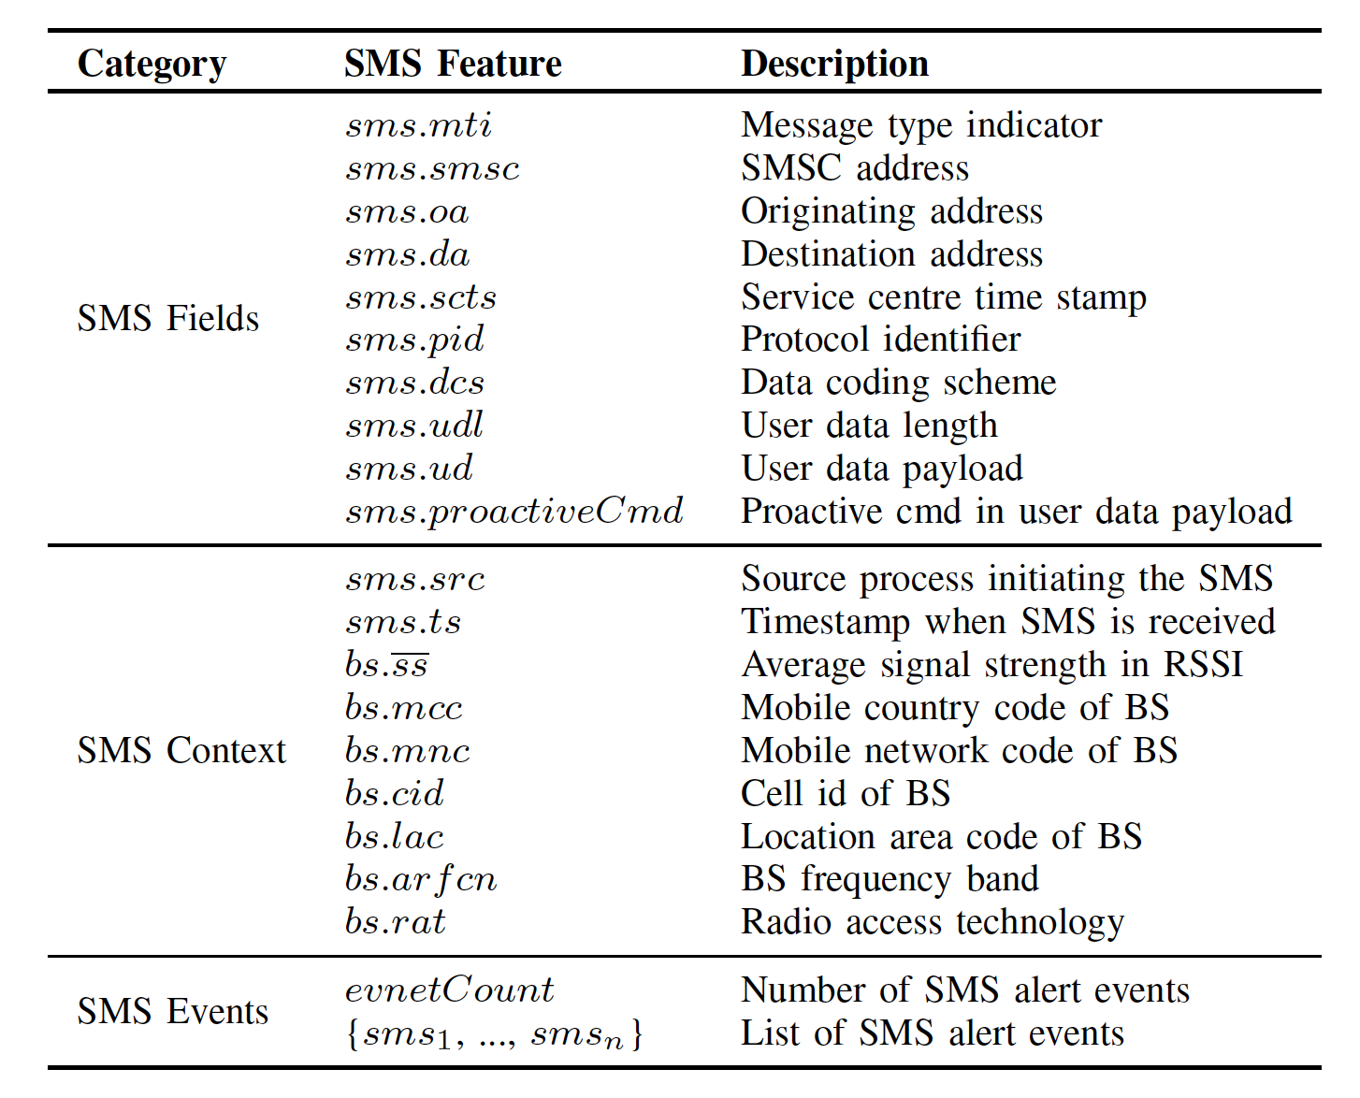
YAML-based Language for Adding New Security Policies
RILDefender can be extended with new SMS Attack Signatures and Mitigation Strategies
SMS Fields: are extracted from the payload
SMS Context: the context (meta-data) pertaining to the source from which the SMS is sent or received
SMS Events: past SMS events can also be tracked
in a list {sms₁, …, sms_{n}} in temporal order, and each
event contains the corresponding SMS fields and context.
SMS Events: There are 4 mitigation directives:
Allow
Notify
Block without Notify
Block and Notify

Slide 8
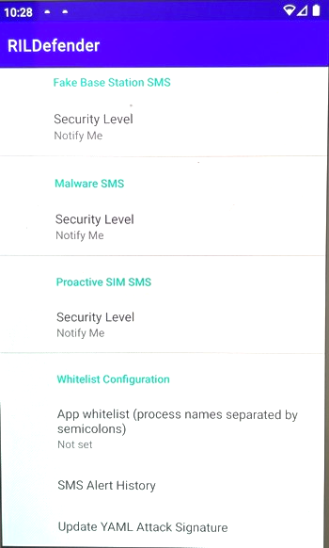
RILDefender: User Interface
Specify Security Policy
Specify the level of protection, including Allow, Notify, Block without Notify, Block and Notify
Whitelist of trusted sources (e.g., to allow law enforcement agencies to track your phone)
NEW

Slide 9
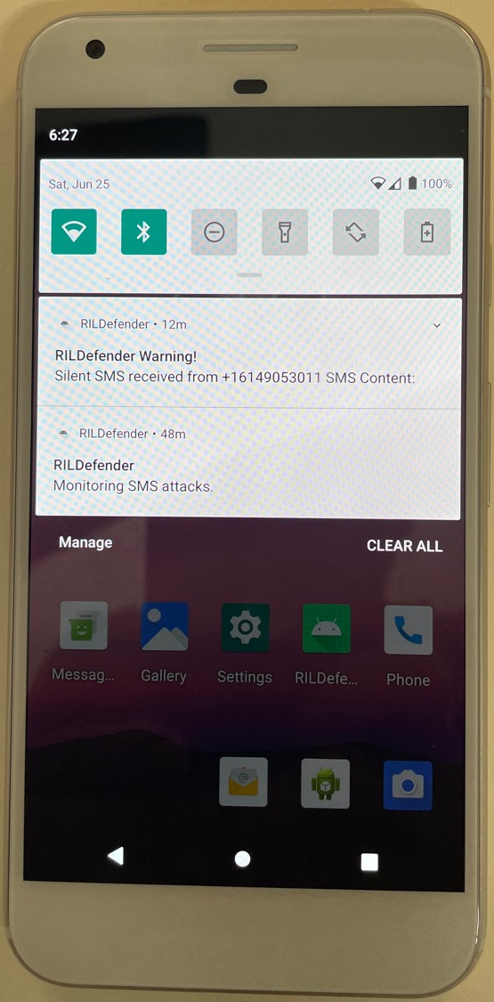
RILDefender: Recent Alert
Detect (and Block) Silent SMS
Notify-only Mode
Silent SMS received from +16149053011 SMS Content
Constructing the Silent SMS
The PDU payload of the silent SMS message
01000C9110832032744040000CC8329BFD065DDF72363904
Red part is the victim’s phone #: +13802234740 (little endian encoding)
Blue part is the protocol identifier: 0x40 stands for short message type 0 (according to the GSM standard)
Green part is the data coding scheme (DCS), and we use the default SMS alphabet to encode the message
Use AT command to instruct the USB dongle to send PDU SMS through serial USB interface (connect to your Linux
AT+CMGF=0 (enable PDU mode)
AT+CMGS=24 (send a PDU SMS w/ length of 24 bytes)
<PDU message payload> <ctrl-z>
ZTE MF833V USB Dongle ~$50
Trial SIM - $5

Slide 10
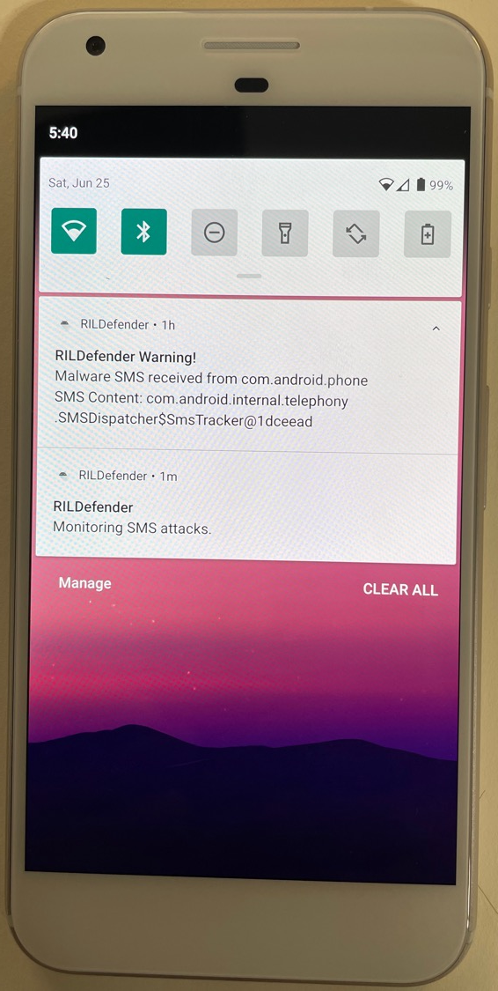
RILDefender: Recent Alert
No Outbound SMS message indicators can be seen from the Android Messenger
App. Without RILDefender we would not have known that an SMS was sent.
Malware SMS Received from com.android.phone SMS Content: com.android.internal.telephony SMSDispatcher$SmsTracker@500e379
FIX: Add the target phone #
NEW - INVESTIGATING:
This indicates some programs other than the SMS app is trying to trigger a SMS sending attempt. The process name com.android.phone is actually the system telephony process.
It appears T-Mobile may have initiated a “proactive SMS”, stimulating the system telephony process to report information back to the MO via SMS.

Slide 11
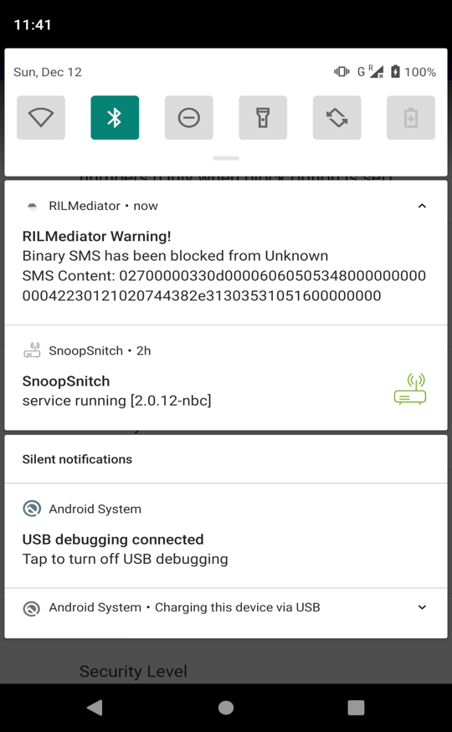
SIMJACKER Detection
Integrate SnoopSnitch to detect non-interactive binary SMS
SEND_SMS, RUN_AT_COMMAND
Use a native binary to poll information from the baseband diagnostic interface /dev/diag
Require root permission
Add logic to parse the binary SMS and notifies RILMediator
If the message is SEND_SMS or RUN_AT_COMMAND
RILMediator will popup a notification to notify user about the message
RILDefender Warning!
Binary SMS was detected from Unknown

Slide 12
Questions of Interest
Android Updates Yes, it survives android updates that do not modify RIL libraries. It will not survive major OS upgrades.
Mobile Operator Detectability of RILDefender
MO’s could infer RILDefender configured to intervene in Silent SMS and Binary SMS logic that contain response logic
MO’s cannot detect Proactive SMS Blocking
MO’s cannot detect RILDefender if it is configured to ALERT-ONLY mode
Malware Operators: Depending on granted permissions could infer presence of RILDefender
Other Cool topics not covered:
RILDefender could be extended to provide control over AT commands sent from AP to CP
RILDefender has additional capabilities to disable or intercede in some baseband functions

Slide 13
Learn More:
Publication:
Haohuang Wen, Phillip Porras, Vinod Yegneswaran, and Zhiqiang Lin, "Thwarting smartphone SMS attacks at the Radio Interface Layer," in Proceeding of the ISOC Network and Distributed System Security Symposium (NDSS), San Diego, CA, U.S.A., February, 2023.
Source Repository:
RILDefender: for Android AOSP 13: https://github.com/OSUSecLab/RILDefender
Patent Pending

